Slide 1
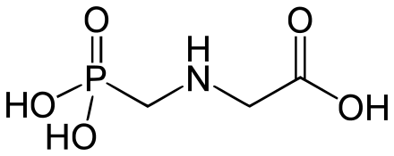
Antea-Glyphosate🍃 Efficient Gly Detection & Degradation System
T
Recombinase polymerase amplification
TOC
Background
Description
Design
Detection🔍
Degradation⚗
Kill Switches🕹
Resources
2020 XMU_China
Track: Food & Nutrition🍗
😺贺靖 2/22/2023

Slide 2
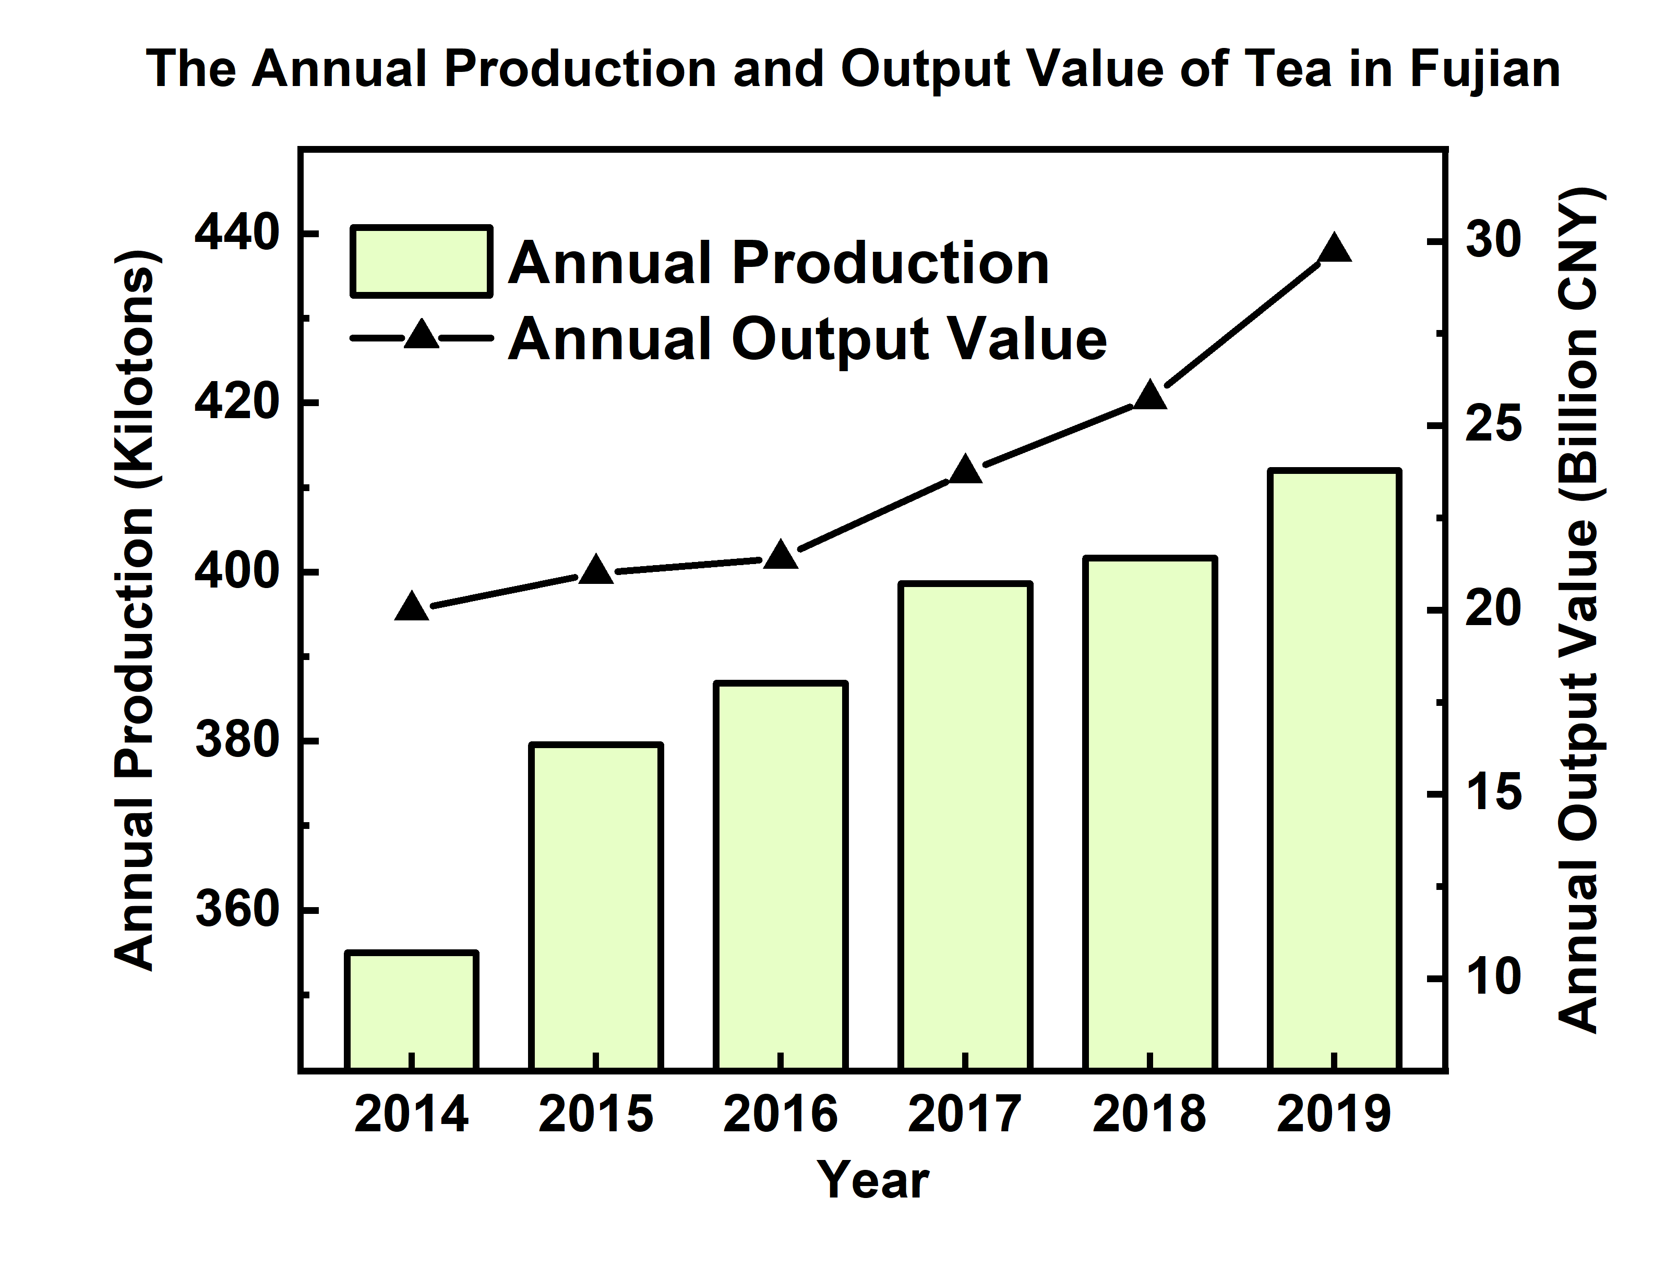
# ​Background
随着现代茶叶种植业的发展，除草剂广泛运用于茶叶生产🍃
农药&除草剂等残留存在较大的食品安全隐患💀
草甘膦 (Glyphosate) 等除草剂暂缺国家标准的农业残留检测方法🔬

Slide 3
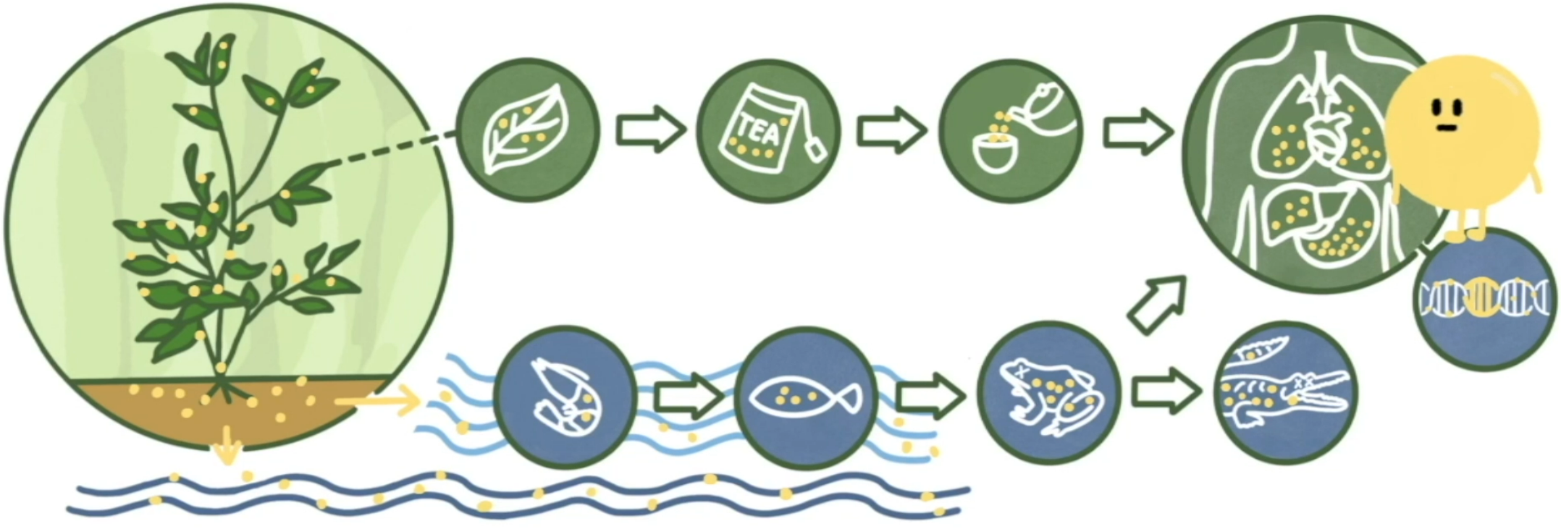
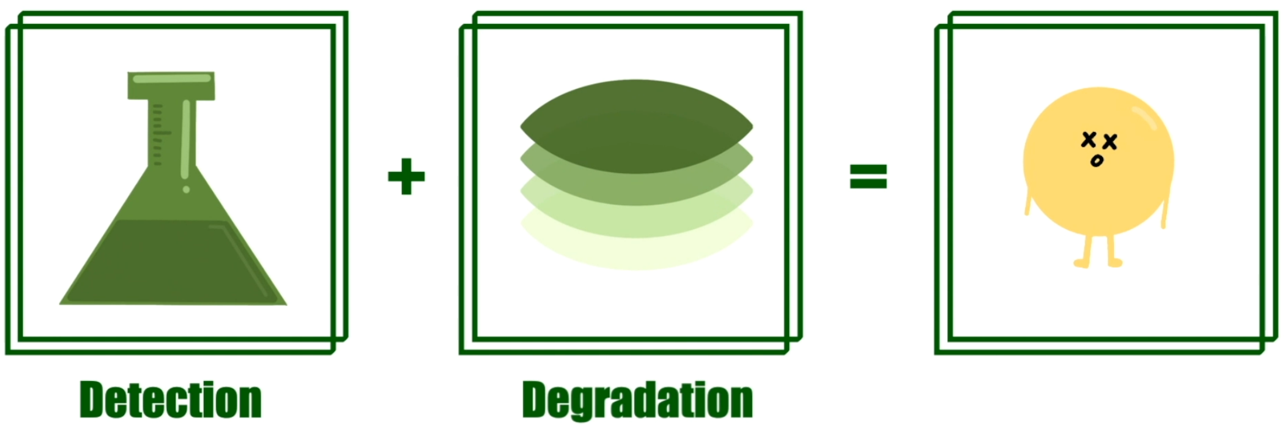
# Description

Slide 4
# Detection🔍
传统检测方法：色谱法🔬
XMU_China 2020: GOX, GRHPR & iNAP System
通过测定草甘膦分解过程中产生的NADPH 间接测定草甘膦的含量
Three Parts Detection
Glyphosate 分解
NADPH 测定
GOX, GRHPR & iNAP System 固定

Slide 5
# Detection🔍
I. Glyphosate 分解
GOX: 一种从名为 EcAKR4-1 的光头稗（草本）中提取的氧化酶
将草甘膦转化成 AMPA（氨甲基磷酸）和乙醛酸
GRHPR: 人乙醛酸还原酶
将乙醛酸转化成乙醇酸，同时会有一分子的NADPH转化为NADP+

Slide 6
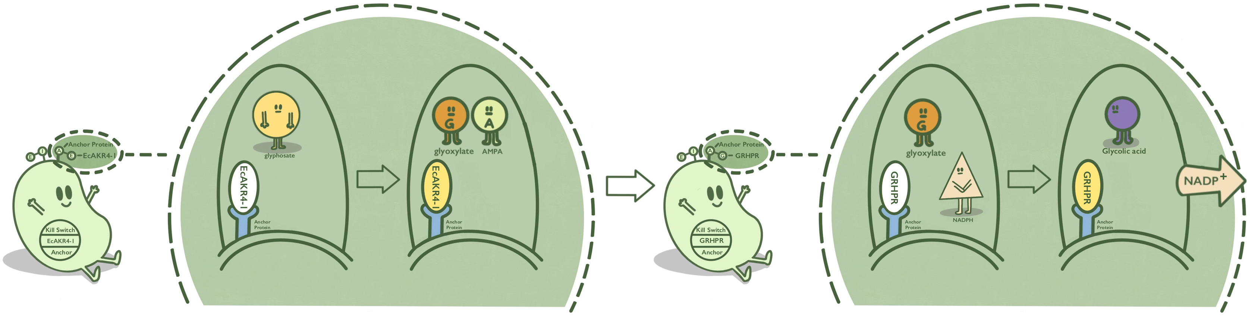
# Detection🔍

Slide 7
# Detection🔍

Slide 8
# Detection🔍
II. NADPH 测定
iNAP：NADPH 传感器（from T-Rex & cpYFP fusion protein)
存在NADPH时，NADPH 与 iNAP 结合使得 iNAP 发生构象变化，产生荧光，进而得到 [NAPDH]

Slide 9
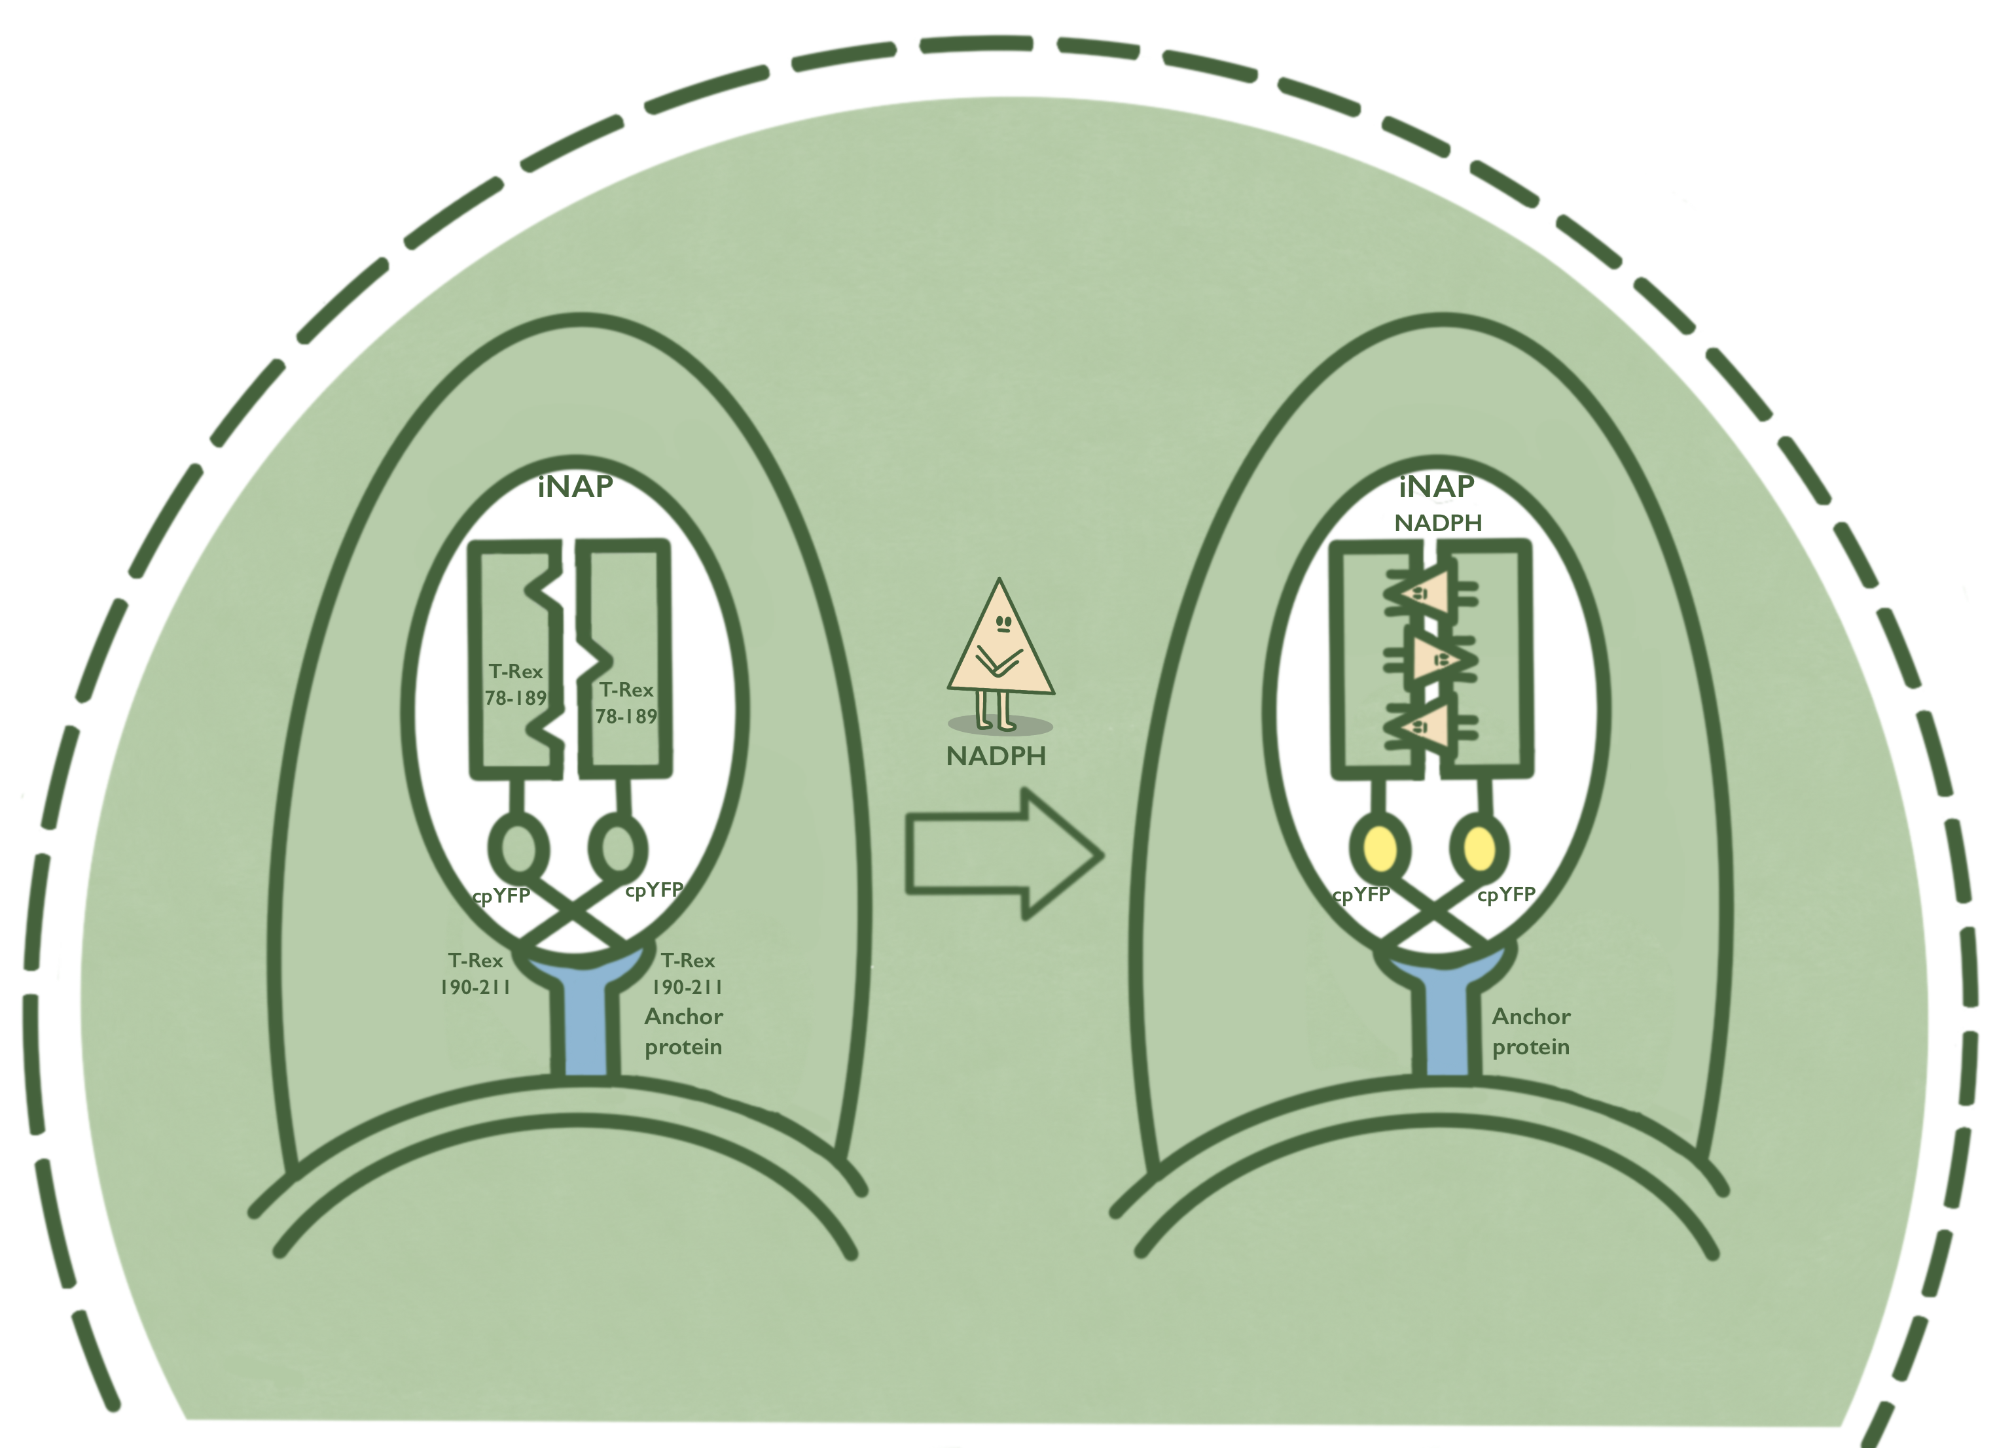
# Detection🔍

Slide 10
# Detection🔍
III. GOX, GRHPR & iNAP 固定
NADPH 作为代谢物普遍存在于细胞中，干扰草甘膦检测
将GOX、GRHPR、iNAP 与 Anchor Protein 融合，使其固定在细胞表面
三种可能的 Anchor Protein
INPNC
BrkA
AIDA

Slide 11
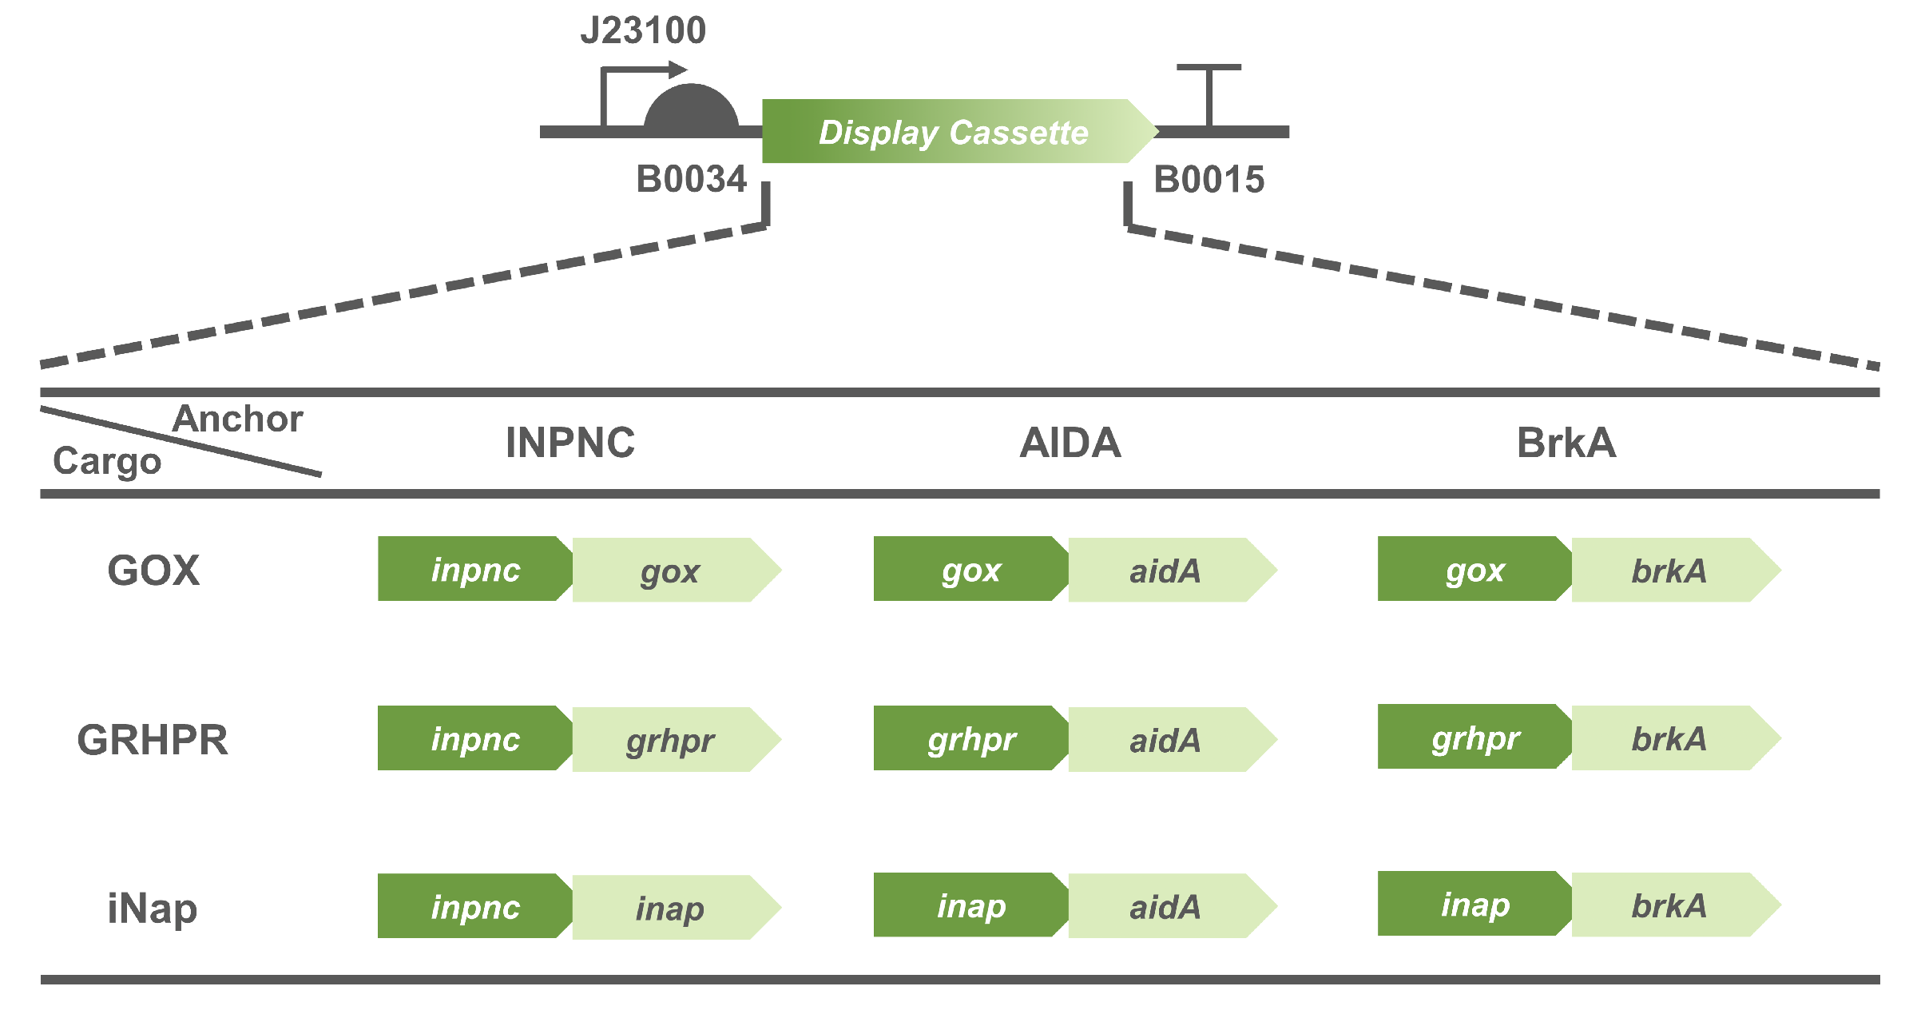
# Detection🔍
Fig | Nine tested fusion protein & Gene circuits of detection system

Slide 12
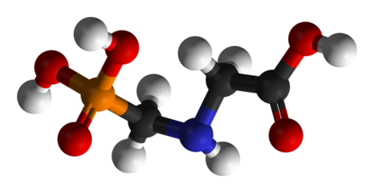
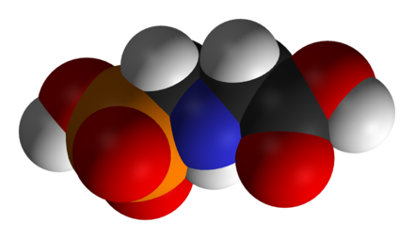
# Degradation⚗
I. Degradation Pathway of Glyphosate
C-N 裂解：生成 AMPA 和 乙醛酸
C-P 裂解：生成肌氨酸和磷酸

Slide 13
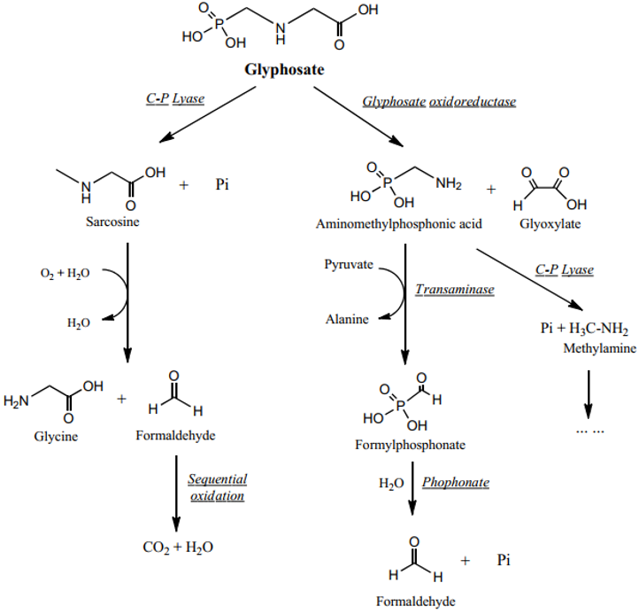
# Degradation⚗
Natural pathway: C-N Cleavage
产生的 AMPA 易残留且有害
C-P 途径产生的 Sarcosine 易氧化形成可循环进出细胞的甲醛
E. coli BL21(DE3) 存在功能失调的C-P Cleavage System

Slide 14
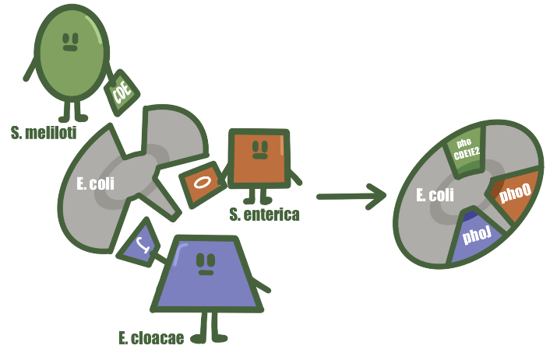
# Degradation⚗
II. BL21(DE3) 三大改造
磷酸的跨膜运输
草甘膦的 C-P 裂解
AMPA 吸收与利用

Slide 15
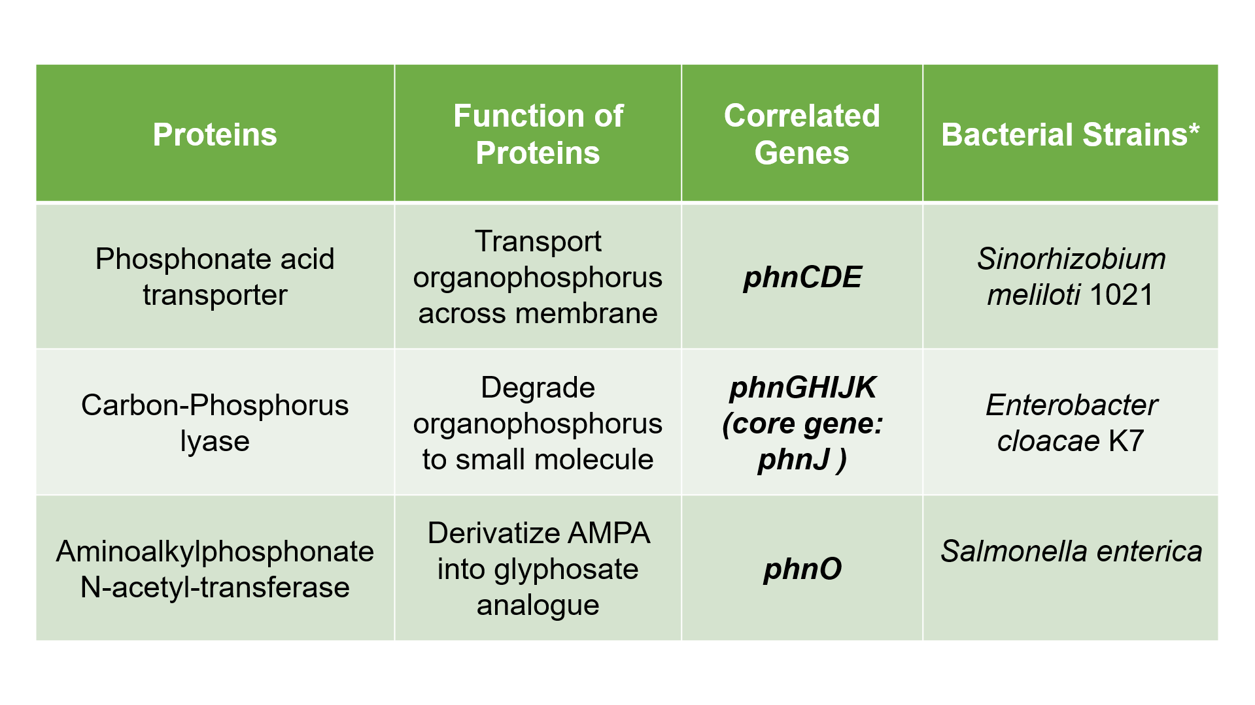
# Degradation⚗
Fig | phn cluster
Notes:
在 S. meliloti （苜蓿中国根瘤菌）1021 对吸收草甘膦和 AMPA 有着特殊性，这是由其 phn 基因的自发突变 phnCDE 引起
E. cloacae (阴沟肠杆菌) K7有着很强的降解草甘膦的能力，其基因 phnJ 编码降解所需的核心部分
S. enterica（肠炎沙门氏菌）中基因 phnO 具有降解利用 AMPA 的能力。因此，他们用这些所需的 phn 基因替代了大肠杆菌中效率较低的同源物

Slide 16
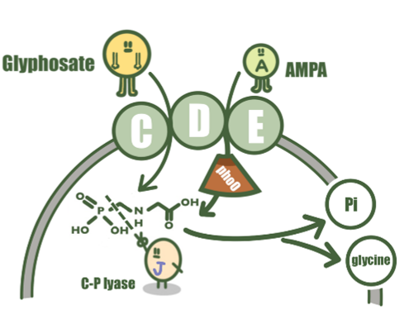
# Degradation⚗
Fig | phn gene cluster mechanism

Slide 17
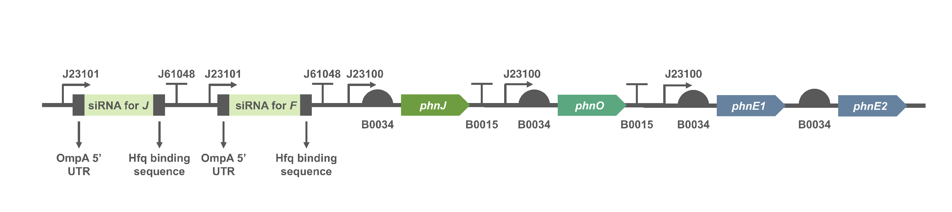
# Degradation⚗
III. The Application of RNAi
phnF(E. coli endogenous) 持续表达抑制 phn cluster
phnF targeted siRNA 阻碍 endo-phnF 的表达，激活草甘膦降解功能
Endo-phnJ targeted siRNA 确保 exo-phnJ 正常表达
Fig | Gene circuit of degradation system

Slide 18
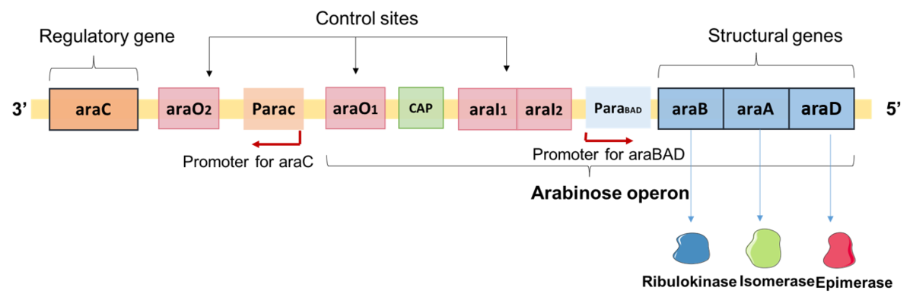
# Kill Switches🕹
I. kill switch in detection system
Fig | Structure of L-arabinose operon of E. coli.

Slide 19
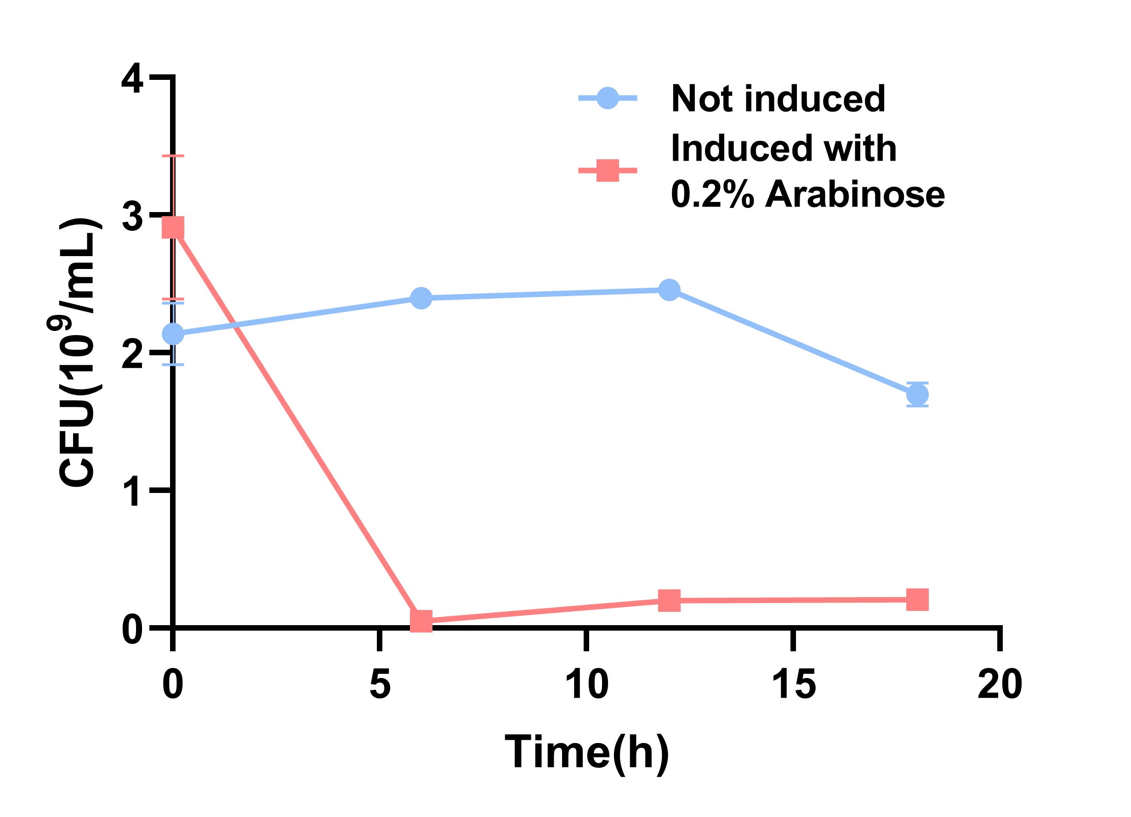
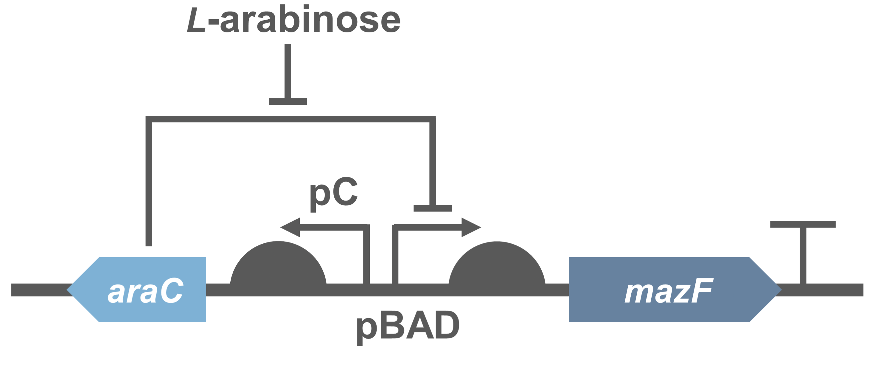
# Kill Switches🕹
kill switch in detection🔍 system
MazF: toxin protein in MazF-MazE (toxin-antitoxin module)
CFU: colony forming units
Fig | PBad/araC-RBS-MazF-terminator

Slide 20
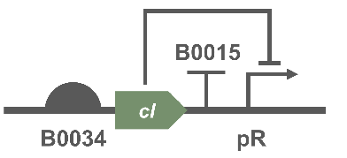
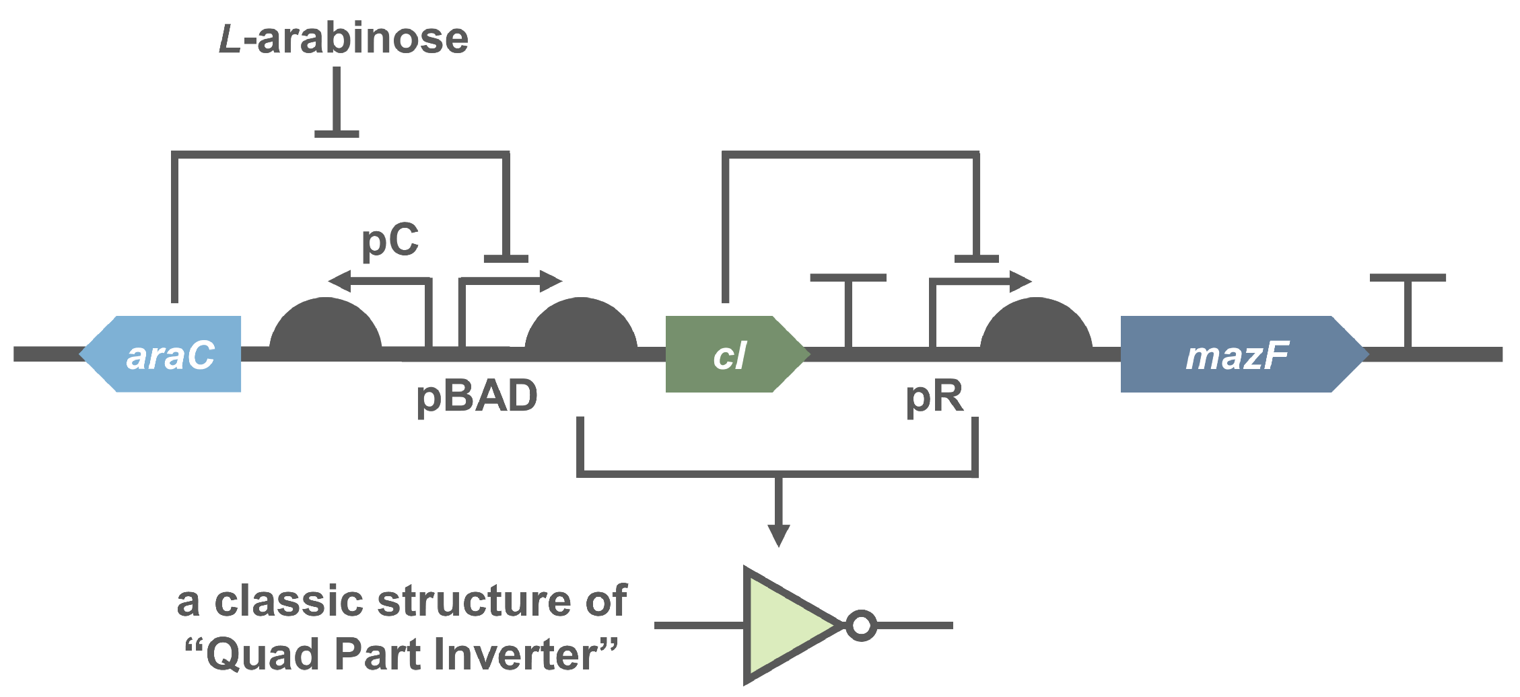
# Kill Switches🕹
kill switch in detection🔍 system
Inverter: cI repressor (from E. coli phage λ)
+ pR promoter which is inhibited by cI repressor
Fig | Inverter
Notes:
Classically, a genetic inverter receives as input the concentration of repressor A and, via gene expression, sends as output the concentration of repressor B.

Slide 21
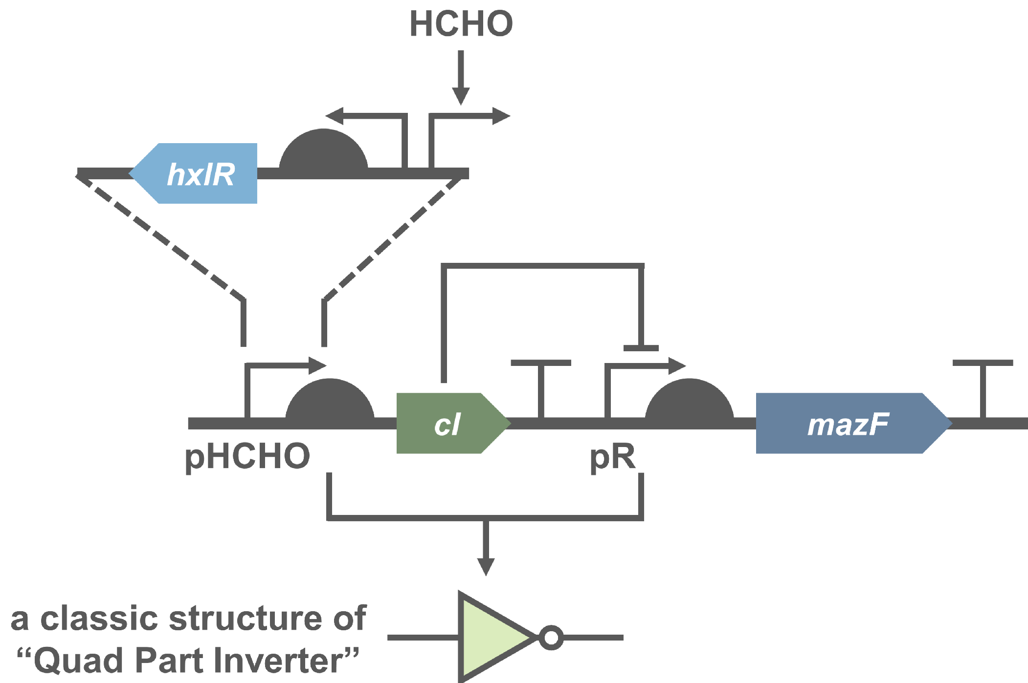
# Kill Switches🕹
II. kill switch in degradation⚗ system
Quad Part Inverter: composed of 4 sub-parts
Promoter (e.g., pλ)
regulated by the encoded repressor protein
RBS
Coding region for a repressor protein
Terminator

Slide 22
# ​Resources
https://2020.igem.org/Team:XMU-China
https://en.wikipedia.org/wiki/Glyphosate
https://en.wikipedia.org/wiki/RNA_interference
https://en.wikipedia.org/wiki/L-arabinose_operon
https://parts.igem.org/Part:BBa_K3332042
https://parts.igem.org/Part:BBa_K1334002

Slide 23


